Slide 1

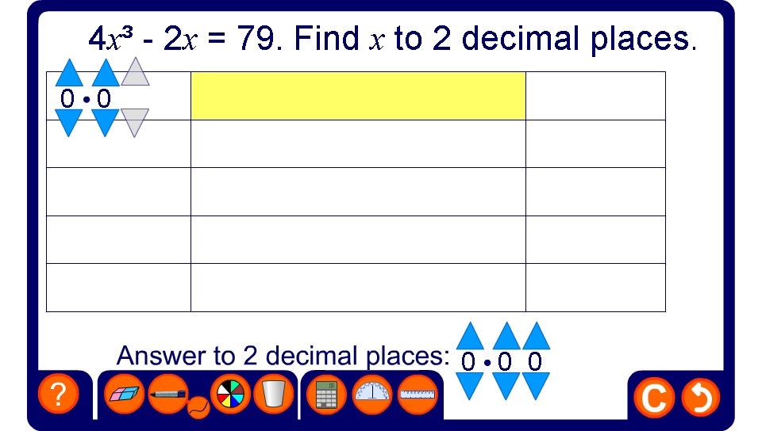


Solving equations by trial and improvement
Notes:
Use this activity to practice finding solutions by trial and improvement.

